Slide 1
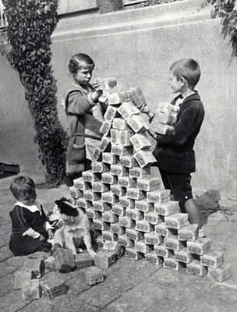
Warm Up
These children are playing with Marks, which was the German currency during the Weimar Republic.
What does this picture tell you about the value of the Mark?
How did this happen?
Explain how you think people in Germany felt about this.

Slide 2
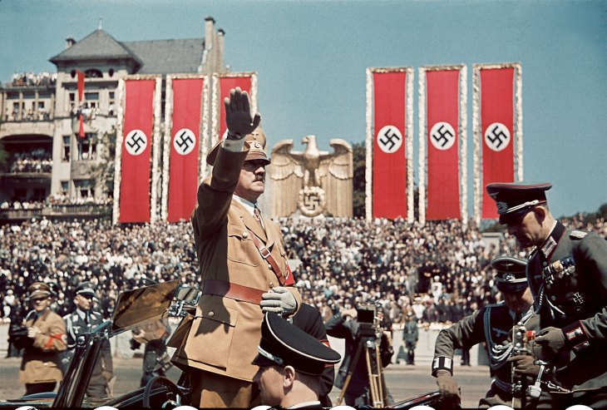
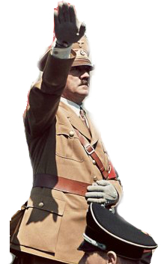
The Rise of Dictators

Slide 3
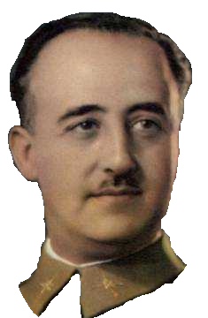
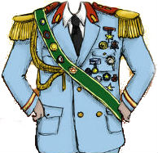
Spain
Gen. Francisco Franco
Falange (Fascist)
Comes to power in civil war with German & Italian help
Neutral in WWII

Slide 4
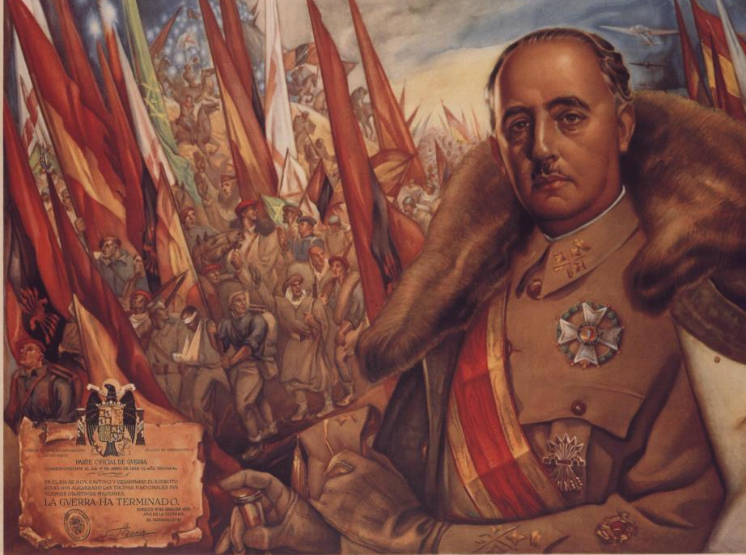
We do not believe in government through the voting booth. Spain has no foolish dreams.
– Francisco Franco

Slide 5
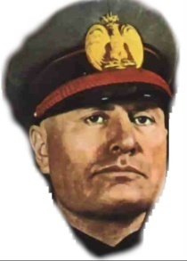
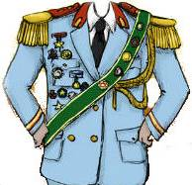
Italy
Benito Mussolini (Il Duce)
Fascist Party
Promises to revive economy & Restore the glory of the Roman Empire
Invades Ethiopia & Albania

Slide 6
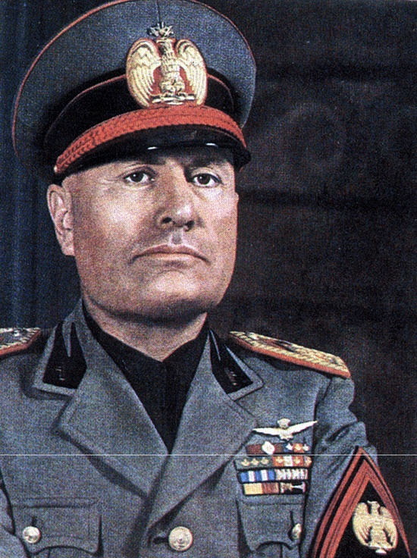
Let us have a dagger between our teeth, a bomb in our hands, and an infinite scorn in our hearts. -Benito Mussolini

Slide 7
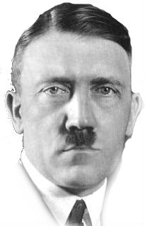
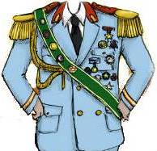
Germany
Adolf Hitler (Der Fuhrer)
Nazi Party
Blames fire in Reichstag on Communists
Uses Jews as scapegoats, published his book Mein Kampf
Takes the Rhineland, Sudetenland, and Czechoslovakia

Slide 8
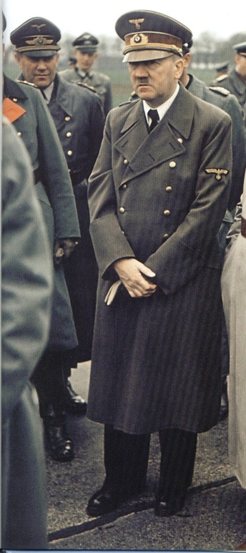
“Make the lie big, make it simple, keep saying it, and eventually they will believe it.”
-Adolf Hitler

Slide 9
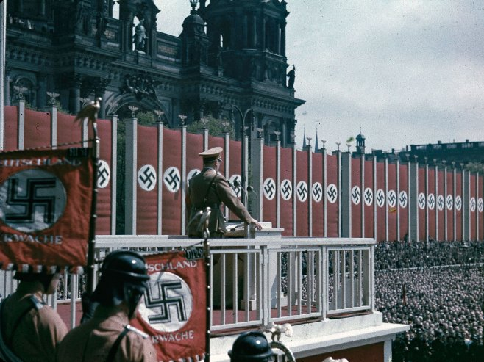

Slide 10
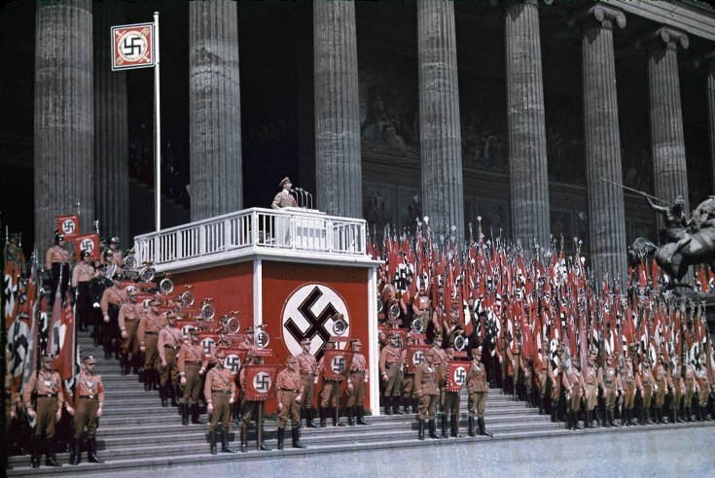

Slide 11
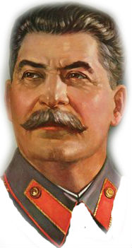
Soviet Union
Joseph Stalin (Man of Steel)
Communist
Eliminates all competition after Lenin’s death
Uses 5 year plans to industrialize
Signs non-aggression pact with Germany & invades Latvia, Lithuania, & Estonia

Slide 12
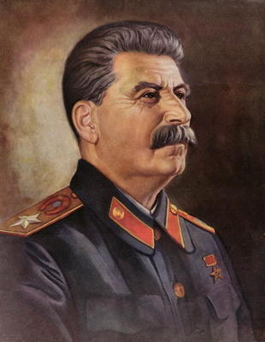
Ideas are more powerful than guns. We would not let our enemies have guns. Why should we let them have ideas?
-Joseph Stalin

Slide 13
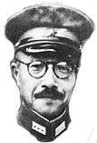
Japan
Gen. Hideki Tojo & Emperor Hirohito
Militarists
Prime Minister Tojo & militarists control the country
Invade Manchuria, China for iron & coal

Slide 14
Emperor Hirohito will believe what we tell him to believe.
-Hideki Tojo

